Slide 1
Artificial Intelligence
CS-451
Instructor : Syed Musharaf Ali

Slide 2
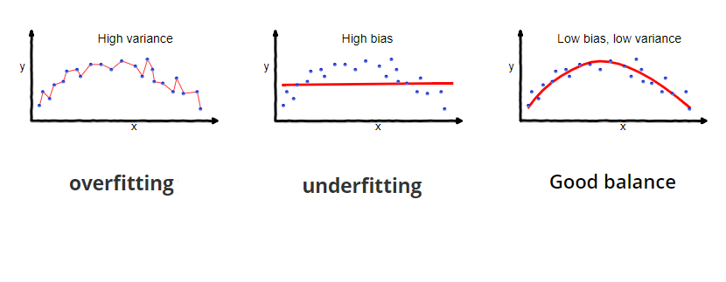
Notes:
Cognitve : process of knowing, learning

Slide 3
Overfitting
Overfitting occurs when a machine learning algorithm fits the data too well.
Specifically, overfitting occurs if the model or algorithm shows low bias but high variance.
Overfitting is often a result of an excessively complicated model, and it can be prevented by fitting multiple models and using validation or cross-validation to compare their predictive accuracies on test data.
Notes:
Cognitve : process of knowing, learning

Slide 4
Underfitting
Underfitting occurs when a machine learning algorithm cannot capture the underlying pattern of the data.
Intuitively, underfitting occurs when the model or the algorithm does not fit the data well enough.
Specifically, underfitting occurs if the model or algorithm shows low variance but high bias.
Underfitting is often a result of an excessively simple model.
Both overfitting and underfitting lead to poor predictions on new data sets.
Notes:
Cognitve : process of knowing, learning

Slide 5
Generalization
Generalization is the model’s ability to give sensible outputs to sets of input that it has never seen before.
A model that generalizes well is a model that is neither underfit nor overfit.
Overfitting is the case where the overall cost is really small, but the generalization of the model is unreliable. This is due to the model learning “too much” from the training data set.
Underfitting is the case where the model has “ not learned enough” from the training data, resulting in low generalization and unreliable predictions.
Notes:
Cognitve : process of knowing, learning

Slide 6
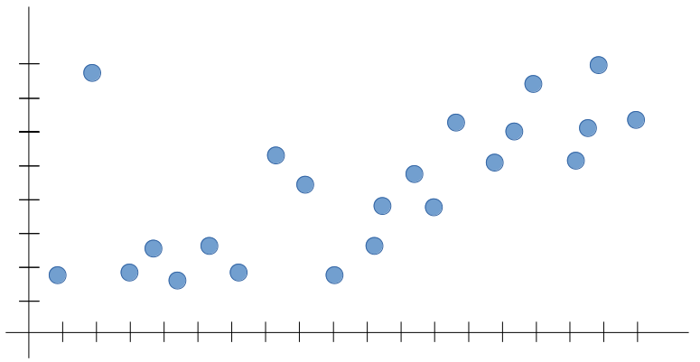
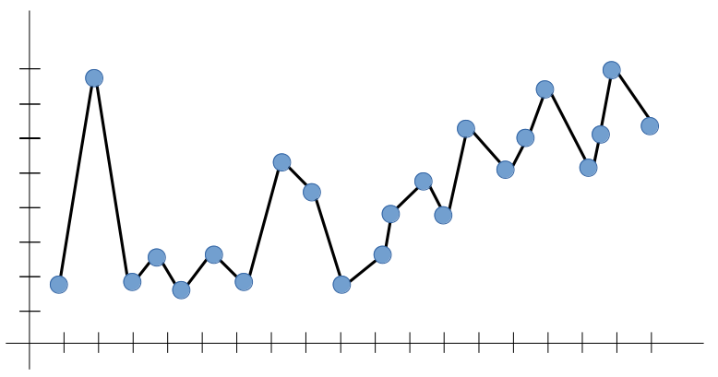
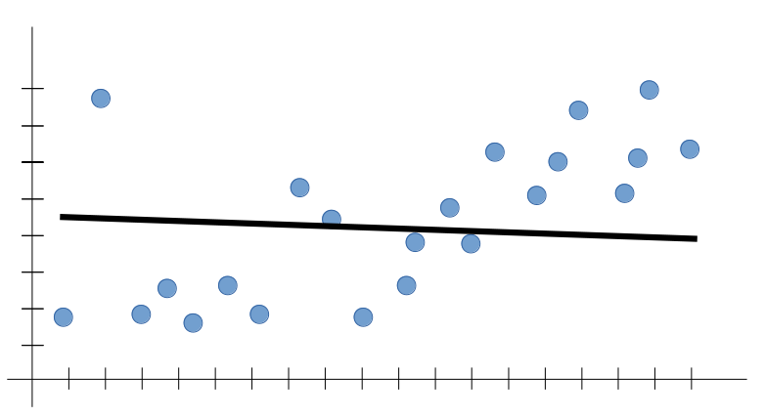
Training Data
Overfitting
Underfitting
Notes:
Cognitve : process of knowing, learning

Slide 7
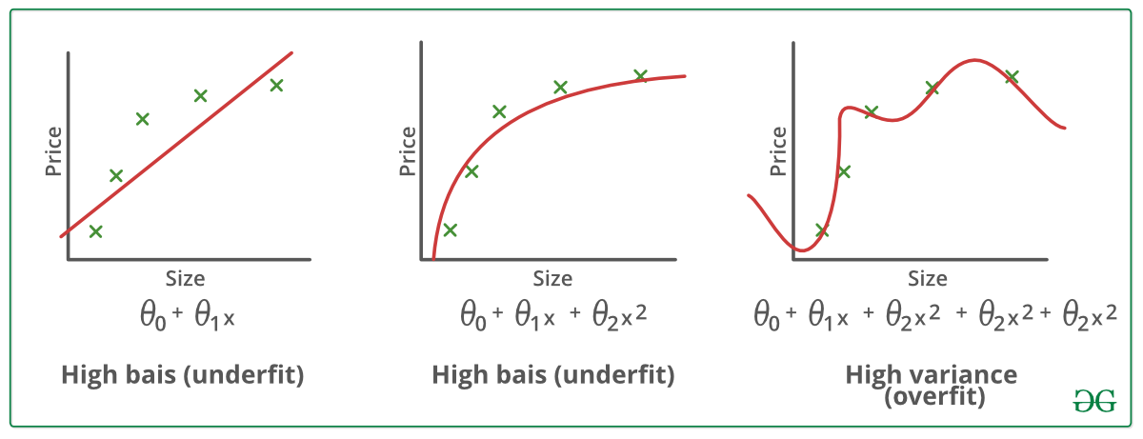
Notes:
Cognitve : process of knowing, learning

Slide 8
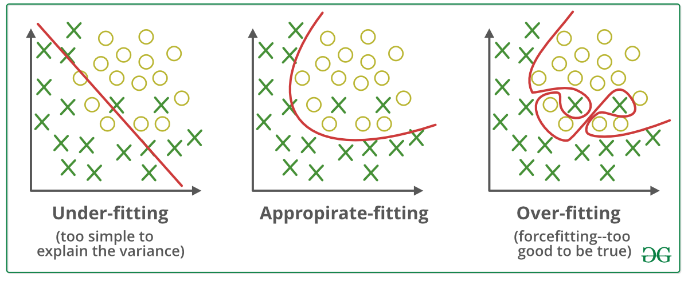
Notes:
Cognitve : process of knowing, learning

Slide 9
Bias
Bias accurs when a machine learning algorithm has the limited flexibility to learn the true pattern from a training dataset
Variance
Variance refers to the algorithm‘s sensitivity to specific sets of traning data
Models with high bias tend to underfit the training data while those with high variance tend to overfit.
Notes:
Cognitve : process of knowing, learning

Slide 10
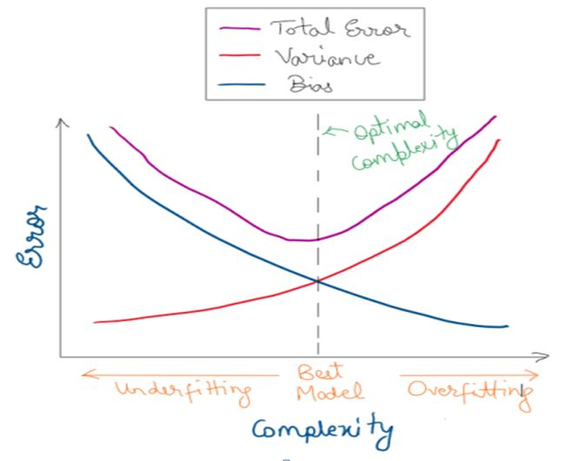
Notes:
Cognitve : process of knowing, learning

Slide 11
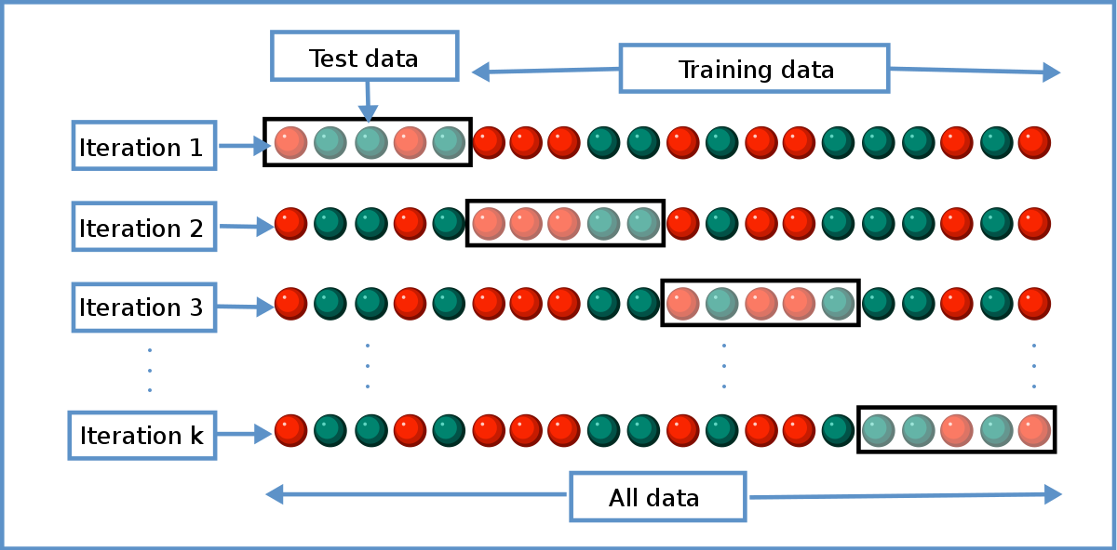
Cross-validation is a resampling procedure used to evaluate machine learning models on a limited data sample. The procedure has a single parameter called k that refers to the number of groups that a given data sample is to be split into. As such, the procedure is often called k-fold cross-validation

Slide 12
Confusion Matrix

Slide 13
Confusion Matrix
A confusion matrix is a table that is often used to describe the performance of a classification model (or "classifier") on a set of test data for which the true values are known.

Slide 14
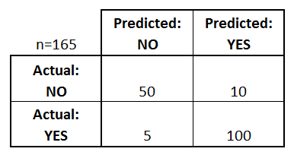
Confusion matrix for a binary classifier (Yes or No)
Yes = Disease (105)
No = No Disease (60)

Slide 15
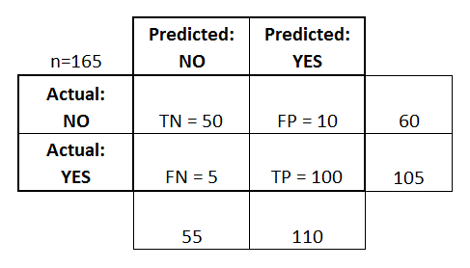
Confusion matrix for a binary classifier (Yes or No)
The classifier made a total of 165 predictions (e.g., 165 patients were being tested for the presence of that disease).
Out of those 165 cases, the classifier predicted "yes" 110 times, and "no" 55 times.
In reality, 105 patients in the sample have the disease, and 60 patients do not.

Slide 16
Confusion matrix for a binary classifier (Yes or No)
Let's now define the most basic terms
True positives (TP): These are cases in which we predicted yes (they have the disease), and they do have the disease.
True negatives (TN): We predicted no, and they don't have the disease.
False positives (FP): We predicted yes, but they don't actually have the disease. (Also known as a "Type I error.")
False negatives (FN): We predicted no, but they actually do have the disease. (Also known as a "Type II error.")

Slide 17
Confusion matrix for a binary classifier (Yes or No)
List of rates that are often computed from a confusion matrix for a binary classifier:
Accuracy: Overall, how often is the classifier correct?
(TP+TN)/total = (100+50)/165 = 0.91
Misclassification Rate: Overall, how often is it wrong?
(FP+FN)/total = (10+5)/165 = 0.09
equivalent to 1 minus Accuracy
also known as "Error Rate“
True Positive Rate(Recall): When it's actually yes,
how often does it predict yes?
TP/actual yes = 100/105 = 0.95
also known as "Sensitivity" or "Recall"

Slide 18
Confusion matrix for a binary classifier (Yes or No)
List of rates that are often computed from a confusion matrix for a binary classifier:
False Positive Rate: When it's actually no, how often does it predict yes?
FP/actual no = 10/60 = 0.17
Specificity: When it's actually no, how often does it predict no?
TN/actual no = 50/60 = 0.83
equivalent to 1 minus False Positive Rate
Precision: When it predicts yes, how often is it correct?
TP/predicted yes = 100/110 = 0.91
https://www.dataschool.io/simple-guide-to-confusion-matrix-terminology/

Slide 19
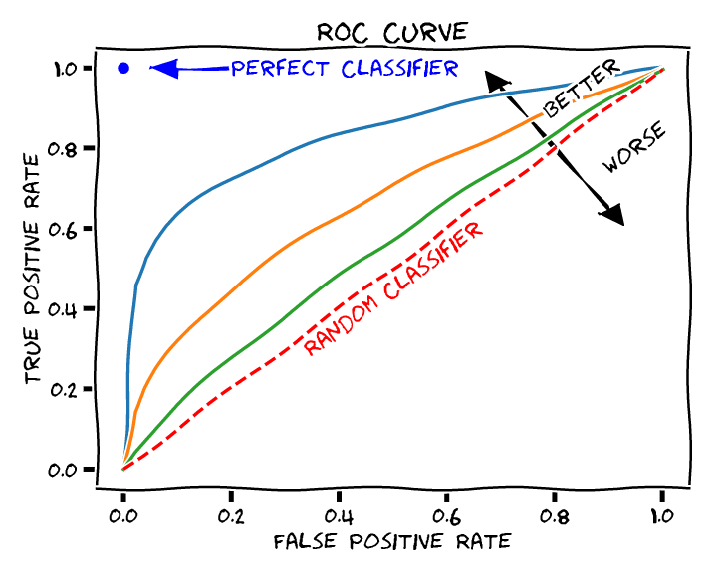
A receiver operating characteristic curve, or ROC curve, is a graphical plot that illustrates the diagnostic ability of a binary classifier system as its discrimination threshold is varied.

Slide 20
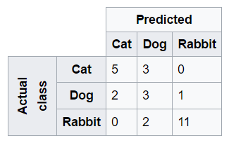
Confusion matrix for a multi class classifier
Find TP, FN, FP, TN for each class?
Find accuracy, Error rate, TPR(Recall) ,FPR, Specificity, and Precision for each class

Slide 21
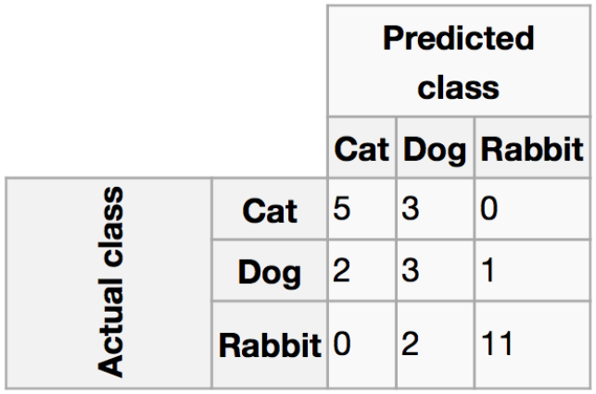
One vs All Strategy
Cat = 8
Dog = 6
Rabbit = 13
Total = 27

Slide 22
One vs All Strategy
Cat vs All
Cat = 8
Dog = 6
Rabbit = 13
Total = 27
TP
TN
FN
FP

Slide 23
One vs All Strategy
Dog vs All
Cat = 8
Dog = 6
Rabbit = 13
Total = 27
TP
TN
FN
FP

Slide 24
One vs All Strategy
Rabbit vs All
Cat = 8
Dog = 6
Rabbit = 13
Total = 27
TP
TN
FN
FP

Slide 25
Readig Assignment
https://machinelearningknowledge.ai/confusion-matrix-and-performance-metrics-machine-learning/
https://www.dataschool.io/simple-guide-to-confusion-matrix-terminology/

Slide 26
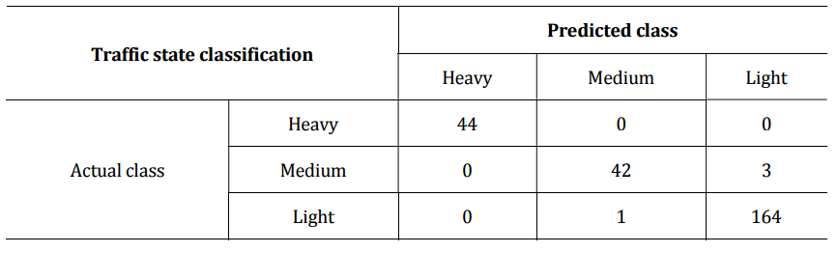
Confusion matrix for a multi class classifier
(i) Find TP, FN, FP, TN for each class?
(ii) Find accuracy, Error rate, TPR(Recall) ,FPR, Specificity, and Precision for each class?
(iii) Find average measures mention in (ii) for the given confusion matrix?

